Slide 1

Optimizing County Operations with AI
Practical Tools for Efficiency & Impact
August 10, 2026

Slide 2

Optimizing County Operations with AI
Mel Kimmel
AI Governance Specialist, AIPolicyPros

Slide 3

Optimizing County Operations with AI
Session Objectives
Identify real use cases
Improve workflows
Launch pilot programs

Slide 4
Optimizing County Operations with AI
Core message
AI is an operations tool
Not a technology trend

Slide 5

Optimizing County Operations with AI
Where time
is lost

Slide 6
Optimizing County Operations with AI
Email overload
Meetings
Reports
Data entry
Repetitive questions

Slide 7
Optimizing County Operations with AI
Key insight
Most problems are workflow problems, not people problems

Slide 8
Optimizing County Operations with AI
Practical Uses

Slide 9

Optimizing County Operations with AI
Writing Support
Emails
Notices
Memos
Reports

Slide 10
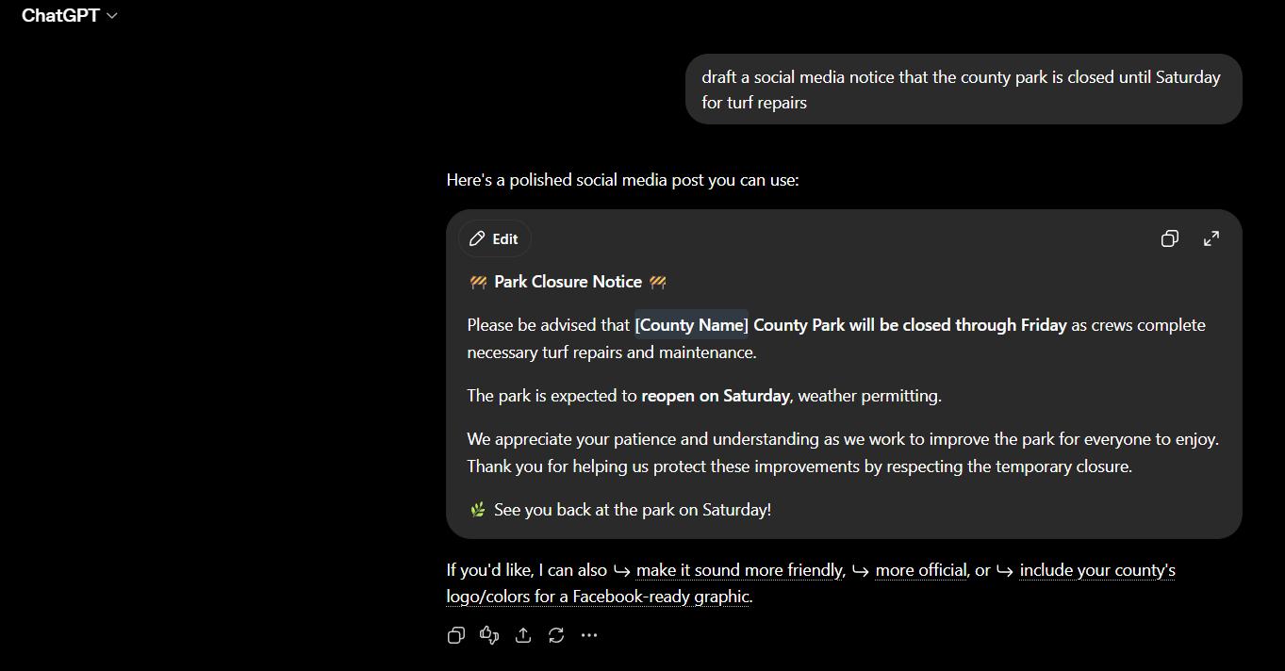

Optimizing County Operations with AI

Slide 11

Optimizing County Operations with AI
Summarization
Board packets
Meeting Notes
Legal docs

Slide 12

Optimizing County Operations with AI
Search & Retrieval
Policy lookup
Faster document access

Slide 13

Optimizing County Operations with AI
Data Organization
Categorize complaints
Identify trends

Slide 14
Optimizing County Operations with AI
Adoption

Slide 15
Optimizing County Operations with AI
Why Adoption Fails
Fear
Lack of training
Poor rollout

Slide 16
Optimizing County Operations with AI
Tips for success
Start small
Train staff
Show wins

Slide 17
Optimizing County Operations with AI
Pilot Plan

Slide 18
Optimizing County Operations with AI
90-day pilot plan
Choose workflow
Measure current state
Run test
Compare results
Decide to scale or stop

Slide 19
Optimizing County Operations with AI
Metrics to track
Time saved
Backlog reduction
Quality
Staff satisfaction

Slide 20
Optimizing County Operations with AI
Metrics to track
Time saved
Backlog reduction
Quality
Staff satisfaction

Slide 21
Optimizing County Operations with AI
Best First Pilots
Meeting summaries
Resident emails
Translation
Report drafts

Slide 22
Optimizing County Operations with AI
Final takeaway
AI should remove friction, not replace judgement

Slide 23
Optimizing County Operations with AI
Call to Action
Start small
Start measurable
Start responsibly

